Slide 1
Disclaimer/s
We hope you find the information on our website and resources useful.
Animations
This resource has been designed with animations to make it as fun and engaging as possible. To view the content in the correct formatting, please view the PowerPoint in ‘slide show mode’. This takes you from desktop to presentation mode. If you view the slides out of ‘slide show mode’, you may find that some of the text and images overlap each other and/or are difficult to read.
To enter slide show mode, go to the slide show menu tab and select either from beginning or from current slide.
You may wish to delete this slide before beginning the presentation.

Slide 3
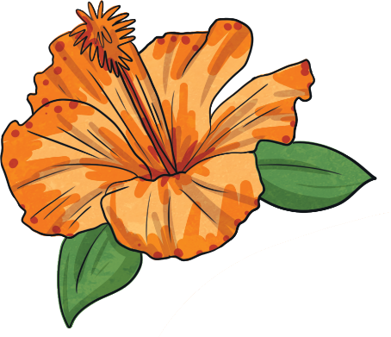
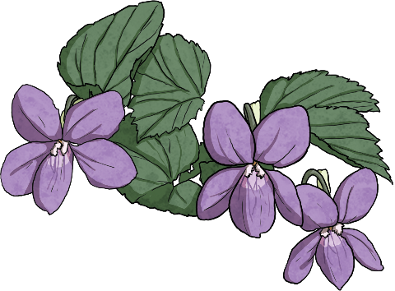
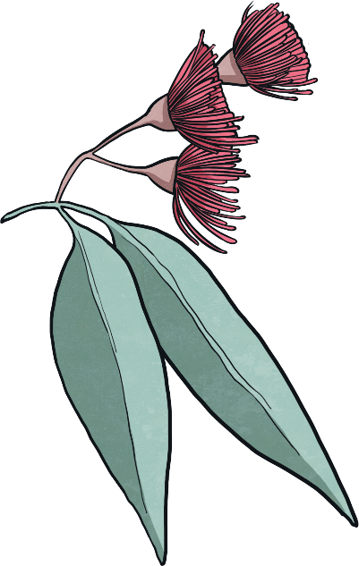
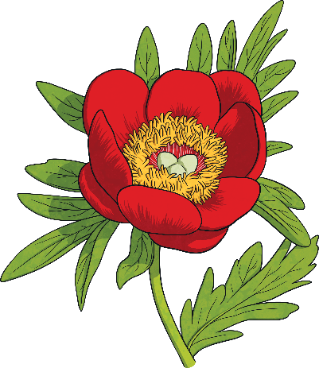
Flowers
There are approximately 369,400 species of flowering plants that exist in the world today.
Each species is unique but every flower will have the same key parts which help it to grow, thrive and reproduce.

Slide 4
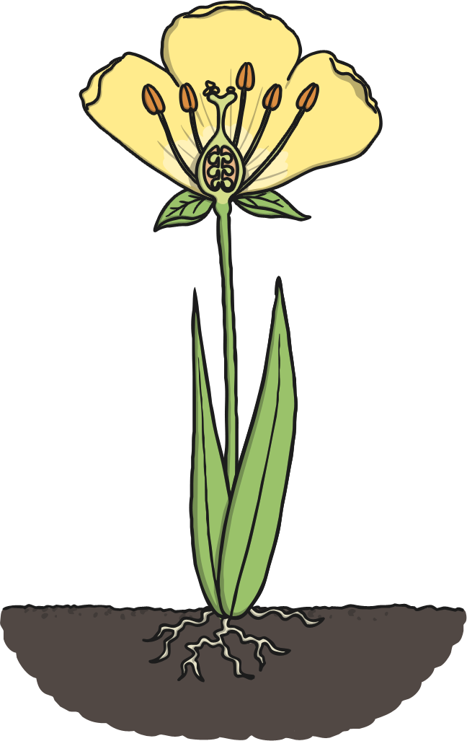
Parts of a Flower
Pollen
Pollen looks a bit like dust and is a bit sticky. It can be blown by the wind or moved around by insects within the same flower or to another flower. The flower makes pollen in the anther, which is the top part of the stamen – the male part of the flower.
Petals
Petals make flowers look beautiful. They are brightly coloured to attract insects and bees to the flower in order to pollinate. Without the pollinators, new flowers could not be made.
1
2
4
3
Stigma
The stigma is the female part of the flower. It is the sticky part at the top of the pistil that stands up in the centre of the flower. It collects pollen from visiting insects, ready for fertilisation to happen.
Stamen
This is the male part of the flower. The stamen is a long part made up of the anther (at the top) and the filament (the ‘stalk’ the anther sits on). The stamen produces the pollen that then goes to fertilise plants for reproduction.

Slide 5
Parts of a Flower
Pistil
The female part of the flower. It is made from the stigma at the top, the style (the long part which links the top and the bottom), and the ovary at the bottom. It is in the pistil that fertilisation of the flower happens.
Ovary
The ovary is the bottom of the female part of the flower, where the ovules are. The ovules get fertilised and new seeds grow in the ovary.
7
5
6
Ovule
This is the part of the flower that gets fertilised and becomes a new seed. Its name comes from the Latin word ‘ovulum’, meaning ‘little egg’.
8
Sepals
Sepals look like a cross between petals and leaves. They protect the flower and its petals before they open out. When you see a flower bud, you will see the sepals covering it up. On some plants that grow fruit, you can still see the sepals after they are picked, for example on strawberries and tomatoes.
9
Stem
The stem of the flower has two important jobs. Firstly, like the roots, the stem helps the flower stand upright and tall. Secondly, it carries water and nutrients that are absorbed in the roots up to the leaves and flower.

Slide 6
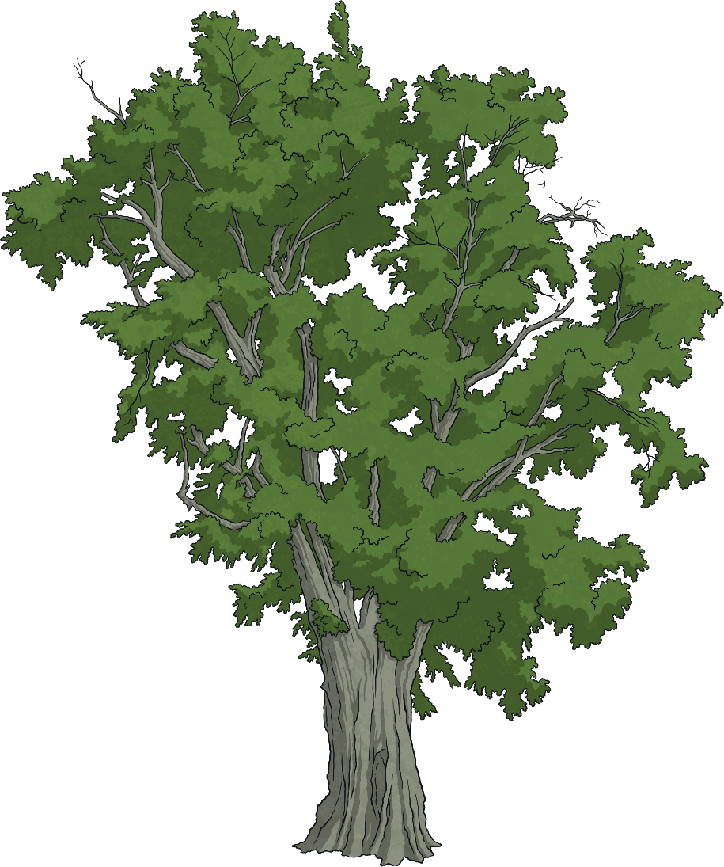
What Do Plants Need?
Air is needed for plants and flowers to grow. Green plants take in carbon dioxide (C0₂) from the air and give out oxygen (0₂).
This is the opposite to what humans breathe in and out. Humans breathe in oxygen and give out carbon dioxide. Plants need air to respire, just like animals do.

Slide 7
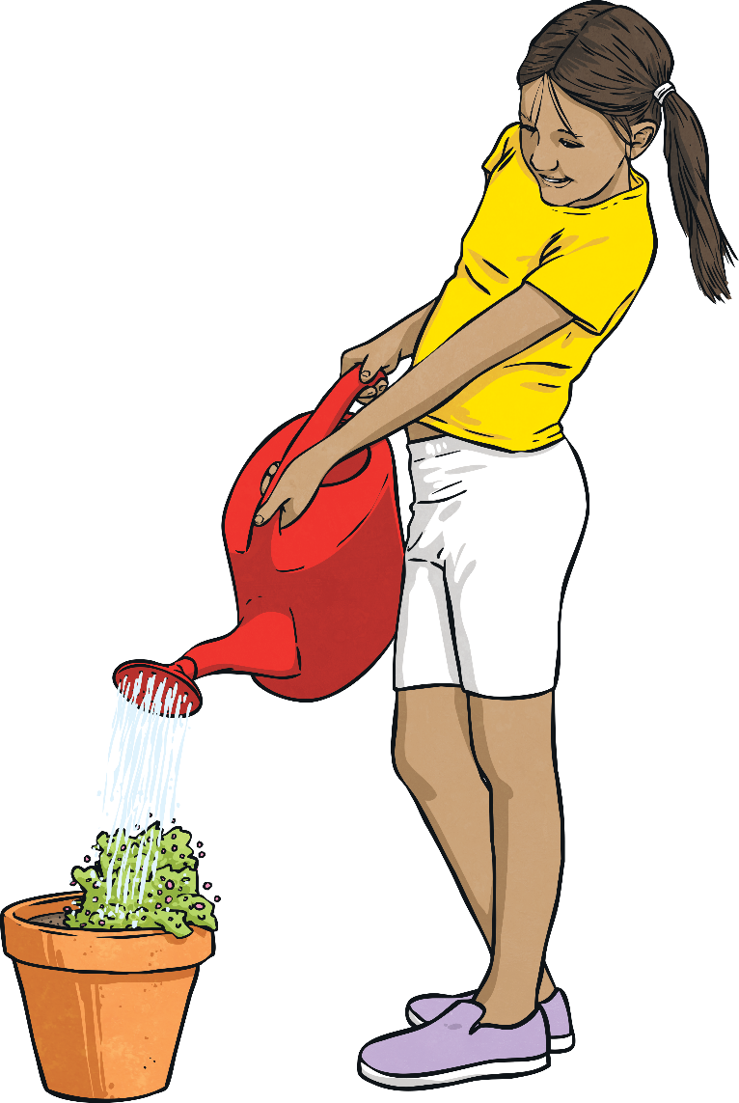
What Do Plants Need?
As well as air, plants need a source of water in order to survive. Plants take up the nutrients from the water which help the plant to grow and thrive. They also help the plant perform photosynthesis – turning sunlight into energy.
However, too much water can cause a plant’s roots to rot which can harm the plant, potentially causing it to die.

Slide 8

What Do Plants Need?
Lastly, plants require sunlight to survive. They use the sunlight for photosynthesis, which turns the sunlight into nutrients for the plant to feed on in order to grow and thrive.
Some plants require more sunlight than others but too much sunlight can harm some plants.

Slide 9
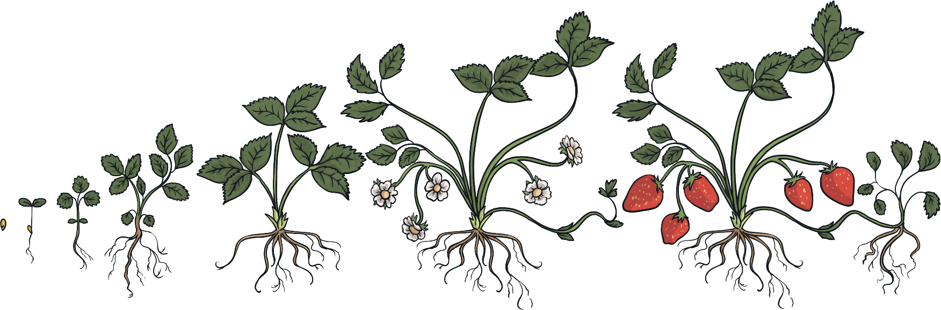
Germination
Germination is when a seed starts to grow into a plant. Seeds on their own cannot germinate - they need to be planted and have air, water and some warmth to start to grow.
First, the seed will crack open as it starts to grow and the first thing to be seen is a tiny green shoot, which tells us the seed is germinating. After the shoot, the plant will continue to grow, producing roots, a stem and leaves.

Slide 10
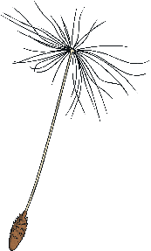
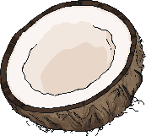
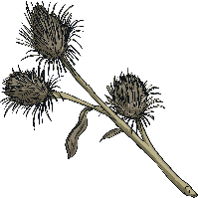
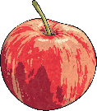
Seed Dispersal
Plants and flowers need to get their seeds moved around to new places in order to grow new plants and spread. This is known as seed dispersal.
Plants do this is a number of different clever ways:
blown by the wind – some seeds are specially designed to be
carried by the wind like parachutes.
explode – some plants pop open, spreading their seeds far and wide.
water – some seeds, such as coconuts, are designed to float in
water and can float across the sea to find new places to grow.
carried by animals – some seeds stick to animals (including
humans) and will eventually drop off in a new place.
eaten by animals – after the seeds have eaten, they will pass through an animal’s body and will be left somewhere else in the animal’s poo.

Slide 11
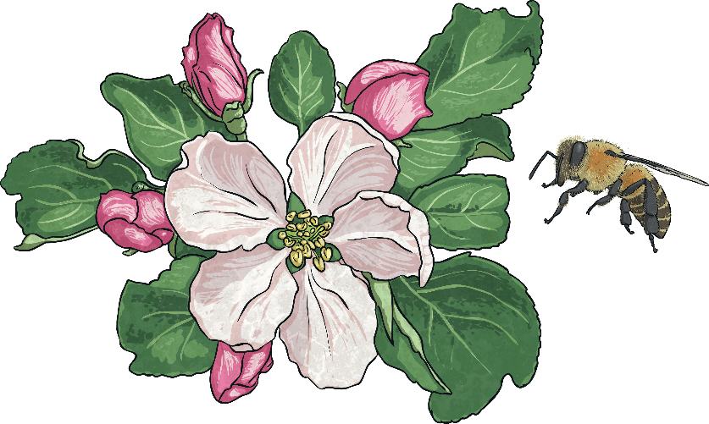
Fertilisation
Fertilisation happens when the male and female parts of the flower have mixed.
Pollen from the male part of one flower sticks to an insect visiting the flower. The pollen is then carried off to another flower, where it sticks to the stigma at the top of the pistil.
The flower is now able to make seeds for new plants.
Did You Know…?
It is estimated that about 1/3 of the food we eat every day depends on bees (and other insects) pollinating flowers!

Slide 12
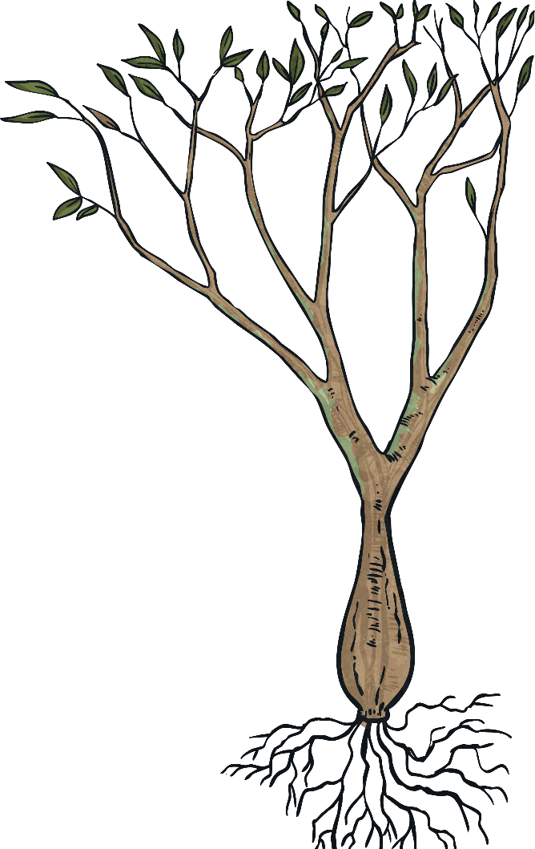
Roots
The roots of a plant are essential for it to survive. They have a number of important jobs:
They collect water and nutrients from the soil.
They keep the plant upright and stable.
Roots vary from plant to plant – they can be long, thin and spread far or they can be thick and sturdy (like the roots of a tree).

Slide 13
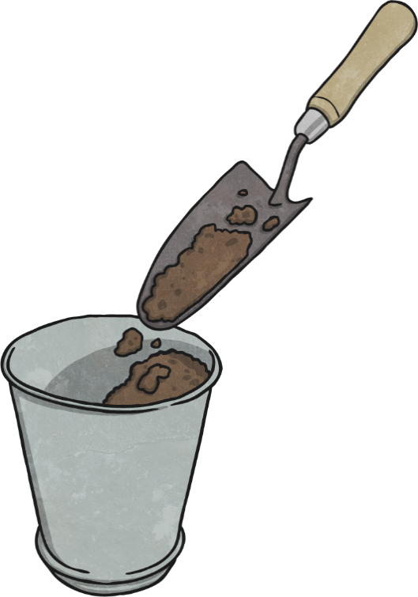
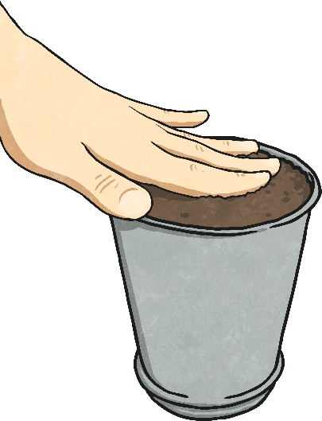
Soil
Many plants grow in soil but some plants can be grown in or on other things, such as water or cotton wool.
Soil makes it easier to grow plants as it keeps everything a plant needs close at hand. It contains the nutrients and water that they need to grow.
Different types of soils contain different minerals which can help plants to grow. Some plants are better suited to one type of soil than others.

Slide 14

Dead Plants
The is the end of a plant’s life cycle. After it has made new seeds, the plant has finished with everything it needed to make them so the plant dies.
Even though it is dead, the plant is still useful as the goodness it contains goes back into the soil to be used by other plants.
A plant can also die if it is missing one of the essential things it needs to grow, such as air, sunlight, water or warmth.
Did You Know…?
Not all plants that look dead are; for some plants, known as ‘perennials’, the above ground part of the plant dies, but the roots survive through the winter and the plant regrows the following year. A peony is a perennial.

